Slide 1
Nuclear Chemistry:
The Risks and Benefits
(OpenStax 20 Gilbert Chapter 21)
Aspects from all sections. The stuff covered in lecture/homework should be your focus.

Slide 2
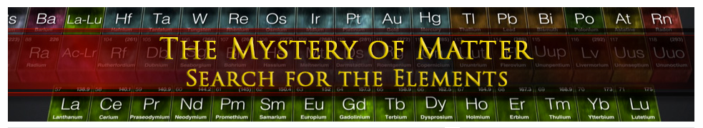
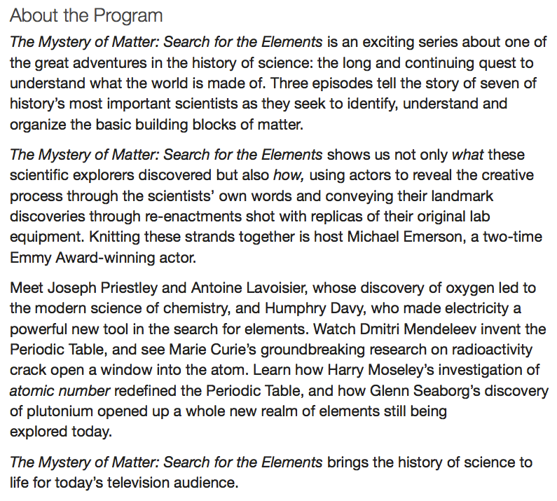

http://video.pbs.org/program/mystery-matter/

Slide 3
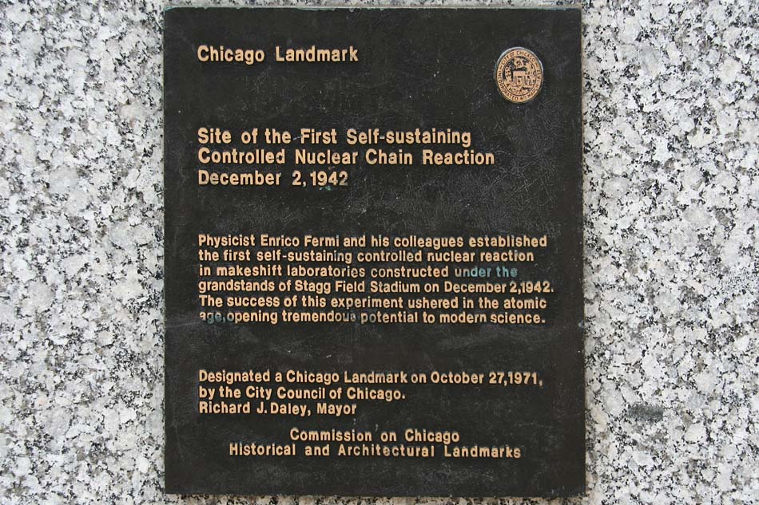
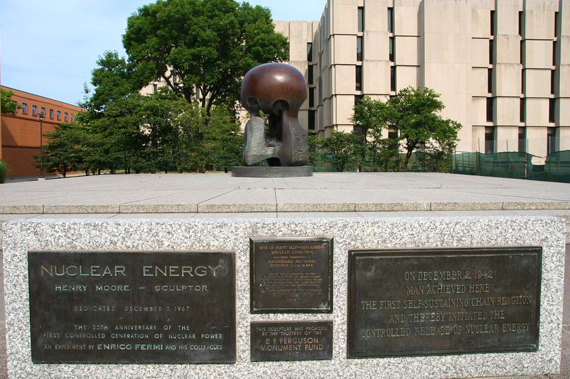
University of Chicago

Slide 4
Nuclear Chemistry
Nuclear Chemistry: The field of chemistry that studies nuclear reactions
Nuclear Reaction: Process that alters the number of neutrons and protons in the nucleus of an atom

Slide 5
Radioactive Decay
Radionuclide: An unstable nuclide that undergoes radioactive decay
Radioactive Decay: The spontaneous disintegration of unstable particles accompanied by the release of radiation
Radioactive Decay Series: The series of spontaneous radioactive decay, ending with an isotope of Pb

Slide 6
Positron Emission
Positron Emission: A form of radioactive decay involving spontaneous emission of a positron from a neutron-poor nucleus
Positron = particle with the mass of an electron but with a positive charge
Examples:
proton
neutron
positron
Remember nuclide notation?
(Chapter 2)
sometimes called a “positive beta-particle”

Slide 7
Electron Capture
Electron Capture: Nuclear reaction in which a neutron-poor nucleus draws in one of its surrounding electrons; transforms a proton into a neutron
Example:

Slide 8
Beta (β) Decay
Beta Decay: Radioactive decay involving spontaneous ejection of a β particle (electron) by a neutron-rich nucleus
Examples:
(Note: Mass and charge balance!)
neutron converted to a proton

Slide 9
Alpha (α) Decay
Alpha Decay: Nuclear reaction in which an unstable nuclide spontaneously emits an alpha particle (α particle = He nucleus)
Example:

Slide 10
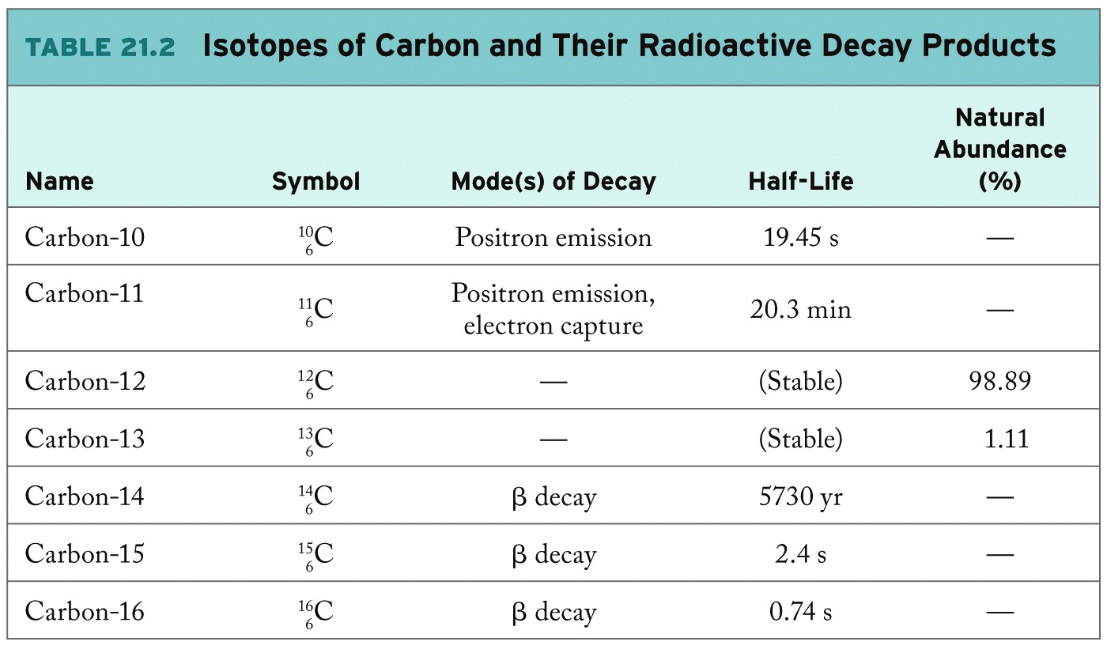
Decay Products of Carbon Isotopes

Slide 11
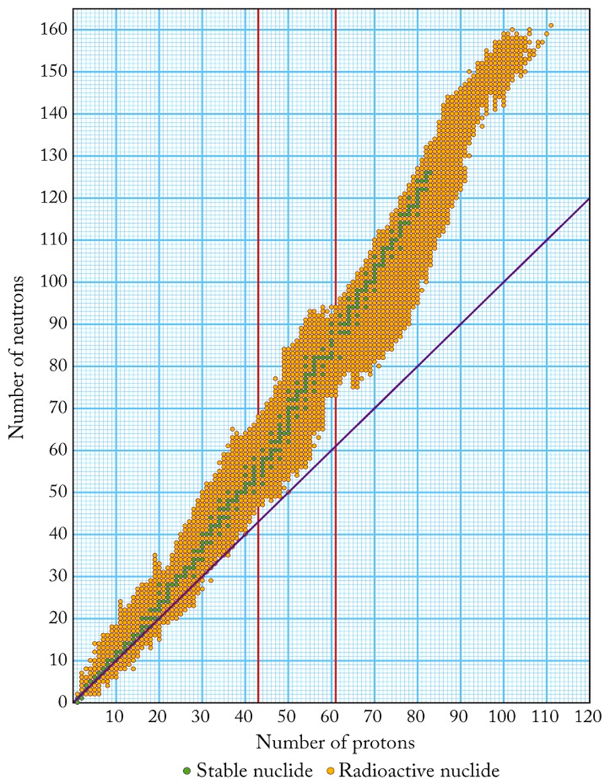
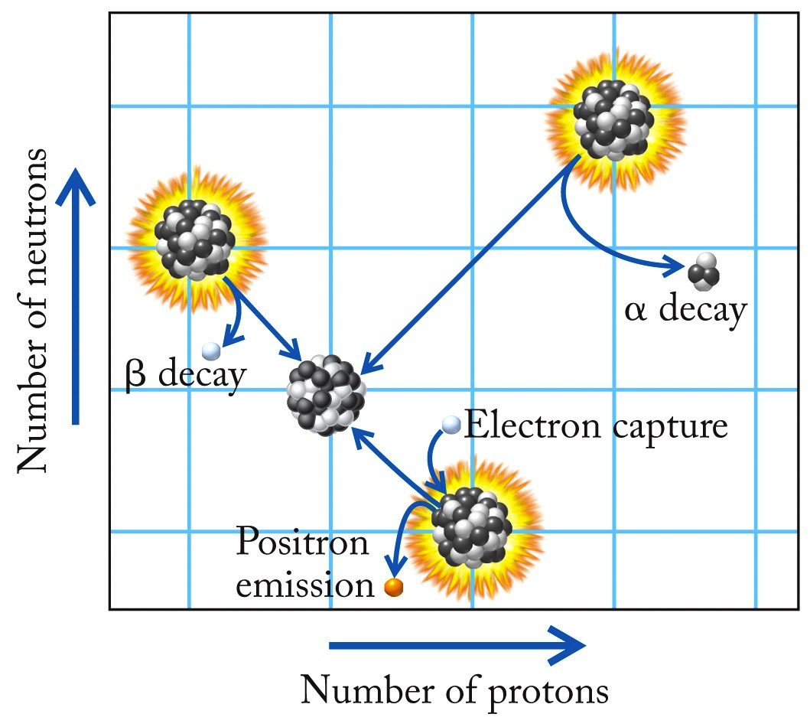
Belt of Stability
Beyond Z = 83, all radioactive, α-decay
Radioactive Isotopes
Stable Isotopes
Neutron rich = β-decay
Neutron poor = positron emission, electron capture

Slide 12
Example: Radioactive Decay
¹⁸⁸Re is formed by the decay of ¹⁸⁸W. Write a balanced equation describing the decay process. Why does ¹⁸⁸W not decay by electron capture or positron emission?
Average Atomic Mass for W = 183.84 amu
Significantly more neutrons in W-188, than for more stable isotopes:
Will undergo β-decay:
Electron capture & positron emission are processes driven toward raising neutron-proton ratio…here lowering is energetically favorable

Slide 13
Half-Life 1st order, Radiometric Dating
Number of half-lives
Amount at an arbitrary time
Where:
t = time
t_{1/2} = time to half-life
n = number of half-lives
Where:
N₀ = amount initially present
N_{t} = amount at time t
n = number of half-lives
All of this is derived from 1st order kinetics expressions!
If we know what fraction of sample is left (N_{t}/N₀) and its half-life (t_{1/2}), we can calculate how much time has elapsed.

Slide 14
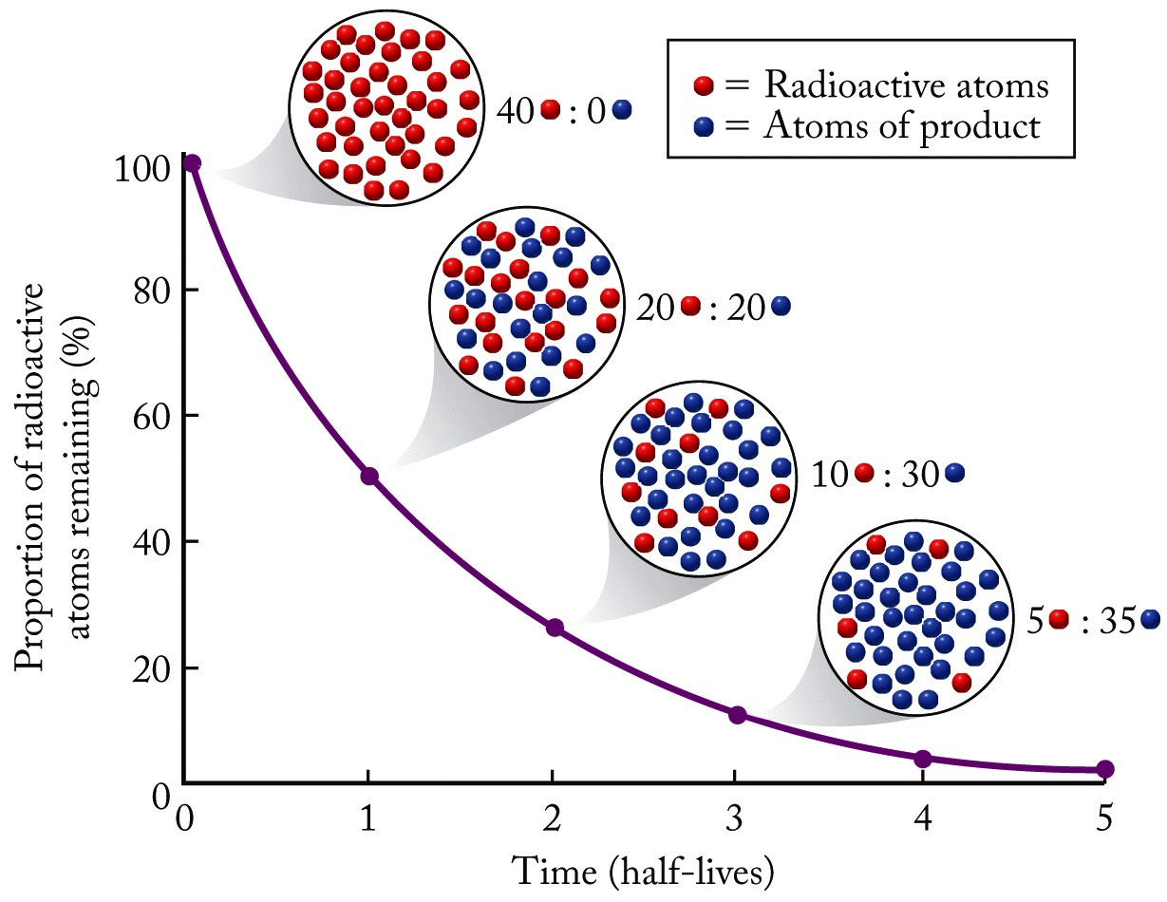
Radioactive Decay: Half-life

Slide 15
Example: Half-Life
Radioactive radon-222 decays with a loss of one α particle. The half-life is 3.82 days. What percentage of the radon in a sealed vial would remain after 7.0 days?
First, calculate number of half-lives
Second, calculate ratio of final to initial
Expressed as a percentage:
Makes sense…2 half-lives would be 25% remaining

Slide 16
Example: Radiometric Dating
A mammoth tusk containing grooves made by a sharp stone edge (indicating the presence of humans or Neanderthals) was uncovered at an ancient camp site in the Ural Mountains in 2001. The ¹⁴C/¹²C ratio in the tusk was only 1.19% of that in modern elephant tusks. How old is the mammoth tusk?
Look up half-life of ¹⁴C:
¹²C is a stable isotope, ¹⁴C is not…so this is a statement about decay
Given:

Slide 17
Biological Effects of Radioactivity
Ionizing Radiation: High-energy products of radioactive decay that can ionize molecules
Becquerel (Bq): unit of radioactivity; 1 Bq = 1 decay event per s
Gray (Gy): The SI unit of absorbed radiation; 1 Gy = 1 J/kg tissue
Relative Biological Effectiveness (RBE): A factor that accounts for the differences in physical damage caused by different types of radiation
Sievert (Sv): SI unit used to express the amount of biological damage caused by ionizing radiation
1 curie (Ci) = 3.70 × 10¹⁰ Bq

Slide 18
Biological Effects of Radioactivity
Wed 22nd is Earth day
Working with nuclear energy or waste
Accidents:
Fukushima Nuclear Power Plant Explosion 2011
Chernobyl, 1986
Three Mile Island 1978
Enrico Fermi Unit 1966
SL-1 Idaho 1961
Sodium Reactor Experiment release 1959 Ca
Windscale 1957 UK
Kyshtym Soviet Union, 1957
Hiroshima, Japan Intentional bombing 1945
Nagasaki, Japan Intentional bombing 1945
Union of concerned scientist
https://www.ucsusa.org/resources/brief-history-nuclear-accidents-worldwide

Slide 19
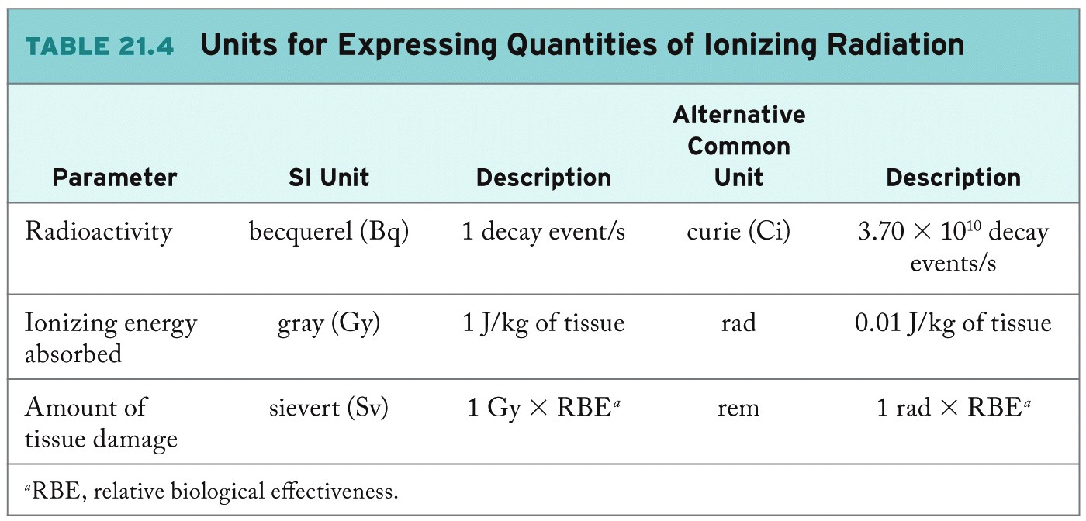
Measuring Radioactivity
In quantifying rate at which radioactive substances decay:
Rate = k[R]
A = kN
t_{½} = 0.693/k
1st order
Where: A = radioactivity; N = # of radionuclides
Where: k = rate constant (decay events/(atom∙s);
t_{½} = half-life (s)

Slide 20
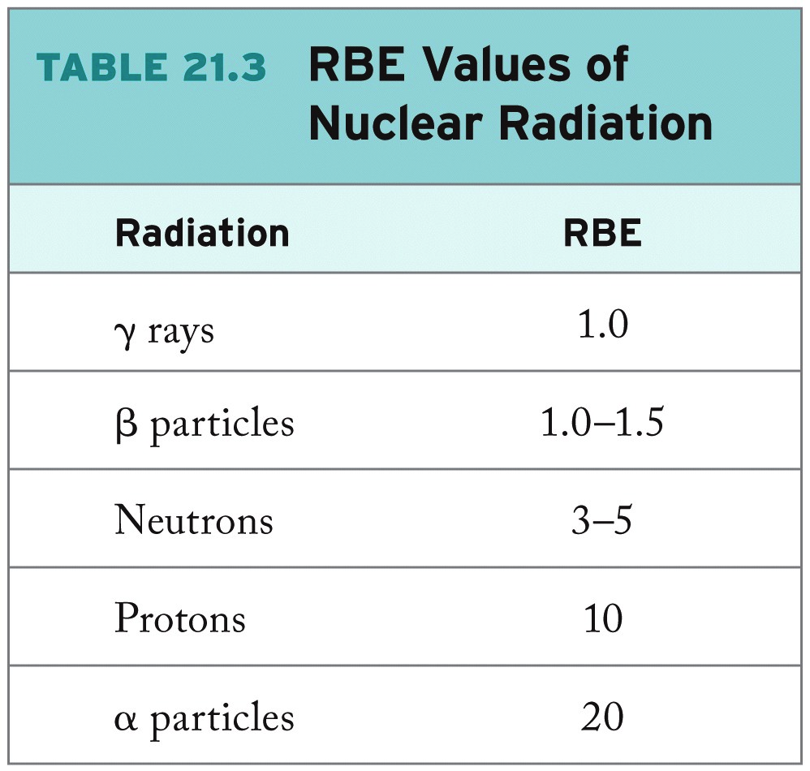
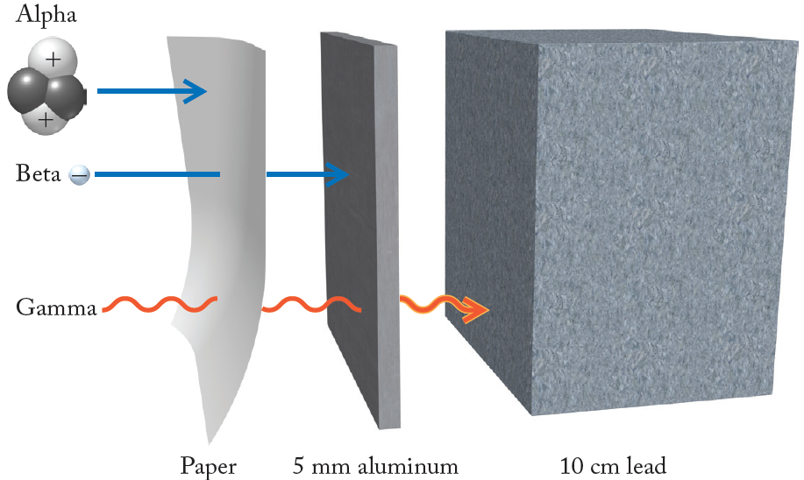
RBE (Relative Biological Effectiveness: Penetrating Power

Slide 21
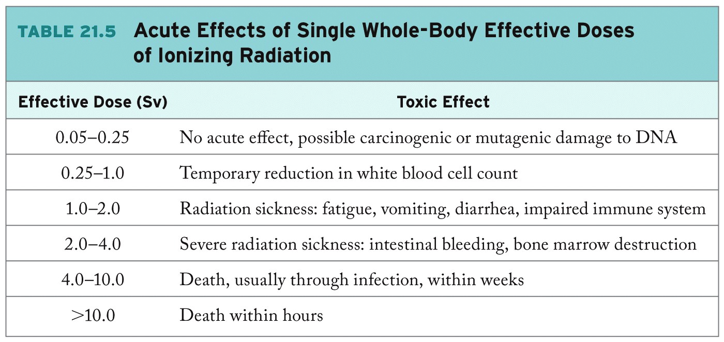
Effects of Ionizing Radiation

Slide 22
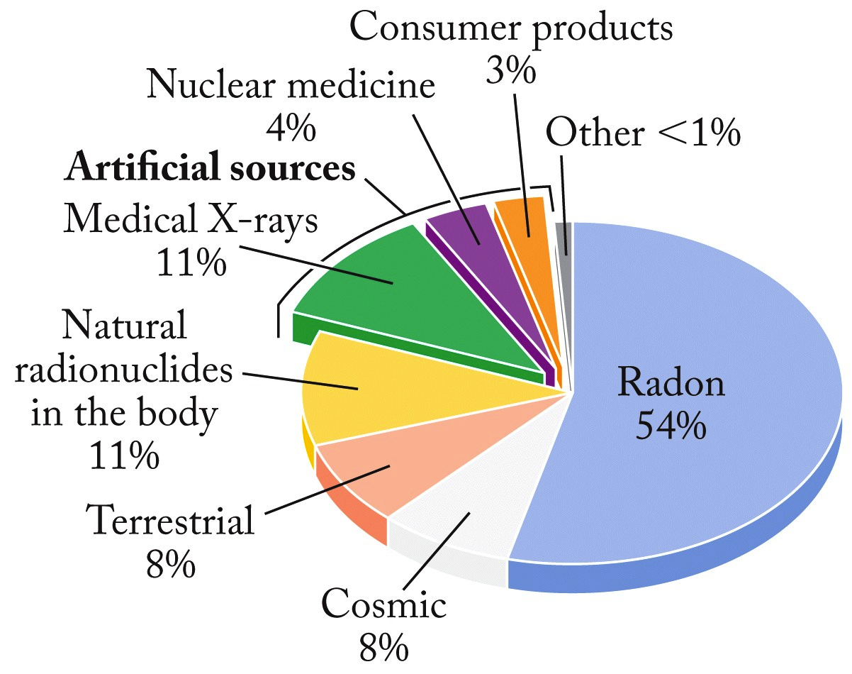
Sources of Radiation

Slide 23
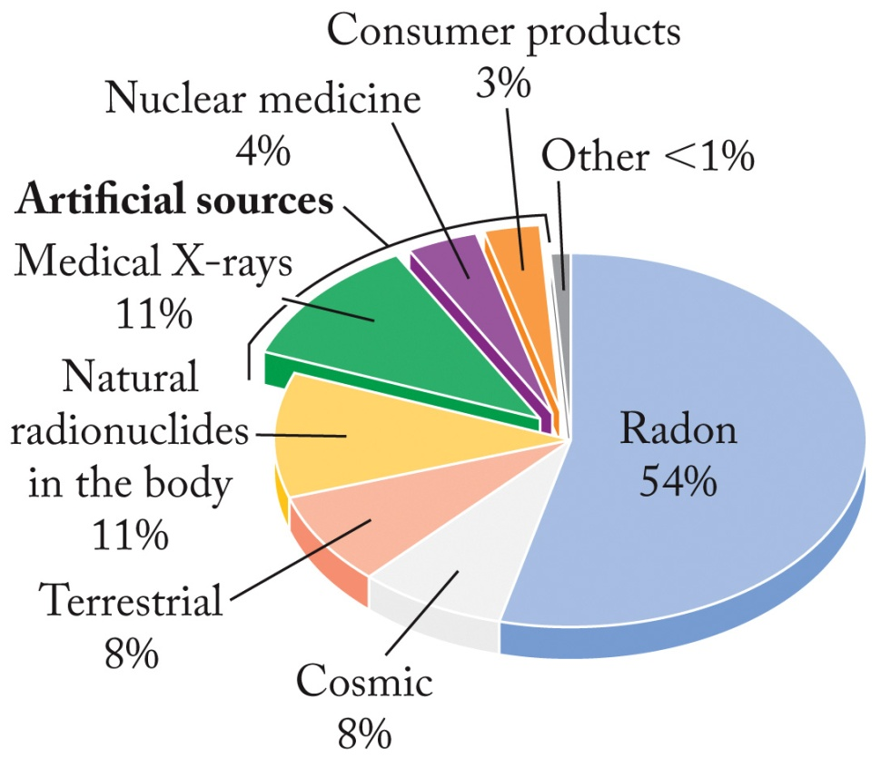
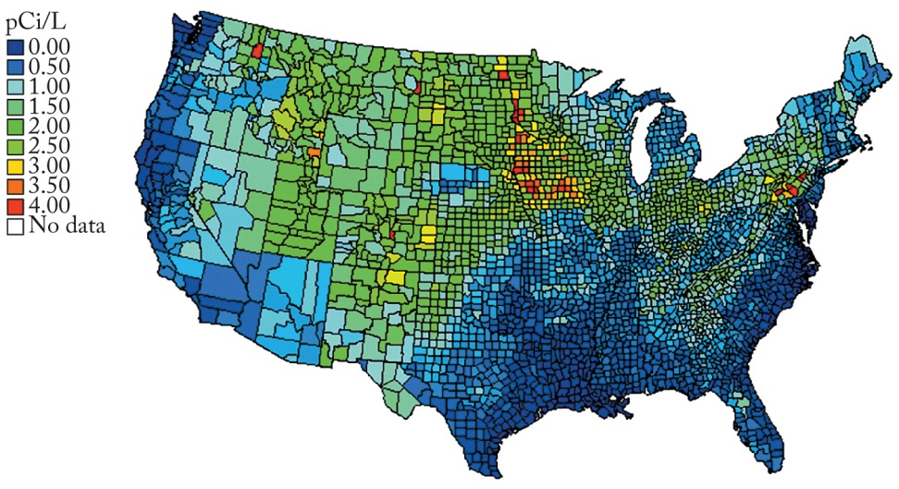
Evaluating the Risks of Radiation
Prominent in the “Midwest”
Notes:
For most people the principal source of radiation is radon gas in indoor air and well water. The radon gas (all isotopes are radioactive) can enter a building through cracks and pores in its foundation. If you breathe radon-contaminated air and then exhale before it decays, no harm is done. If radon-222 decays in the lungs, it emits an a particle that can cause lung damage. Concentrations of radon depend upon geology and on how gas-tight building foundations are. The air in many buildings is 1 pCi per liter of air; the Environmental Protection Agency has established 4 pCi/L as an “action level.”
Figure 21.23 and Figure 21.24

Slide 24
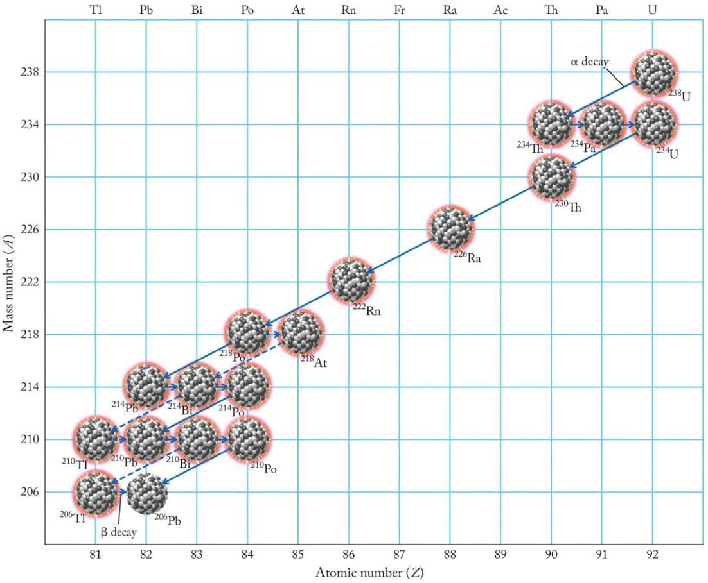
Alpha (α) Decay (Cont. 1)
Radioactive decay series
One radioactive decay process often leads to another until a stable nuclide (²⁰⁶Pb) is formed.
Diagonal arrows = alpha decay – loss of mass number
Short horizontal Beta decay – change in # protons not mass number.
²²² Radon 54% exposure
Notes:
Among the most massive radioactive isotopes the one radioactive decay process often leads to another and another in what is referred to as a radioactive decay series. We can see such a series for the α decay of uranium-238 to lead-206 (stable isotope) in Figure 21.2.
Figure 21.2

Slide 25
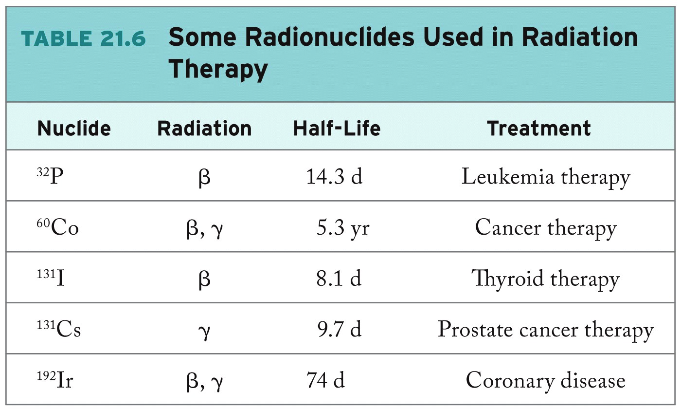
Radionuclides

Slide 26
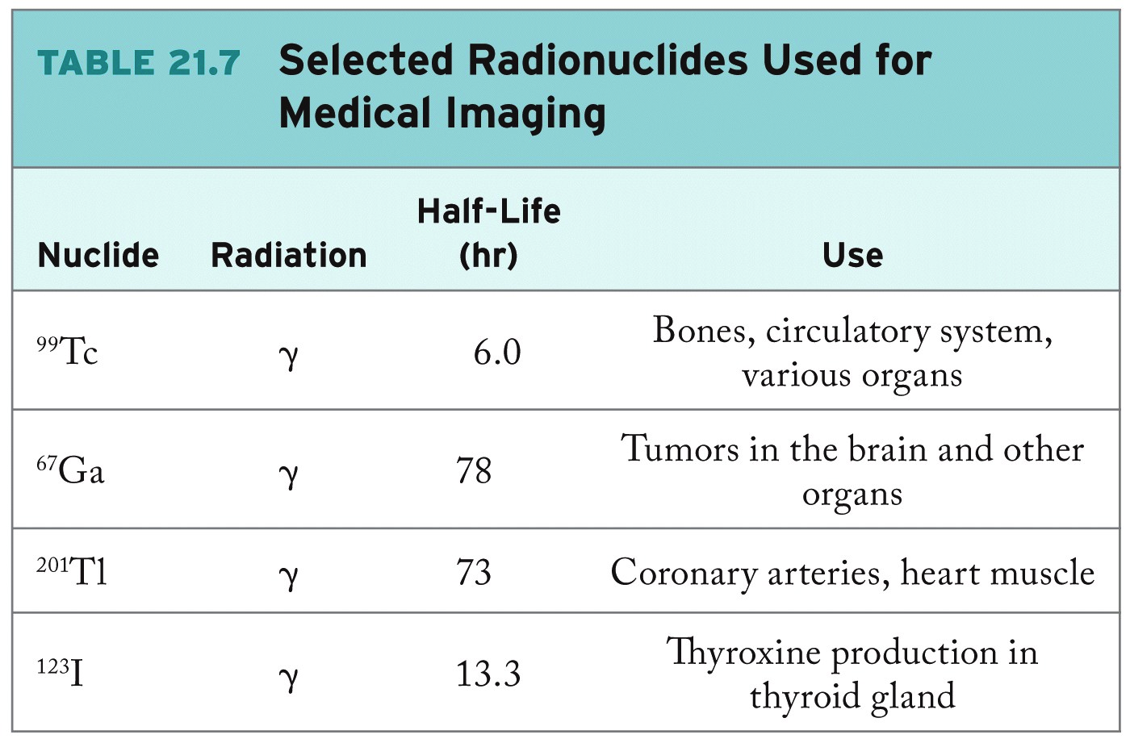
Radionuclides

Slide 27
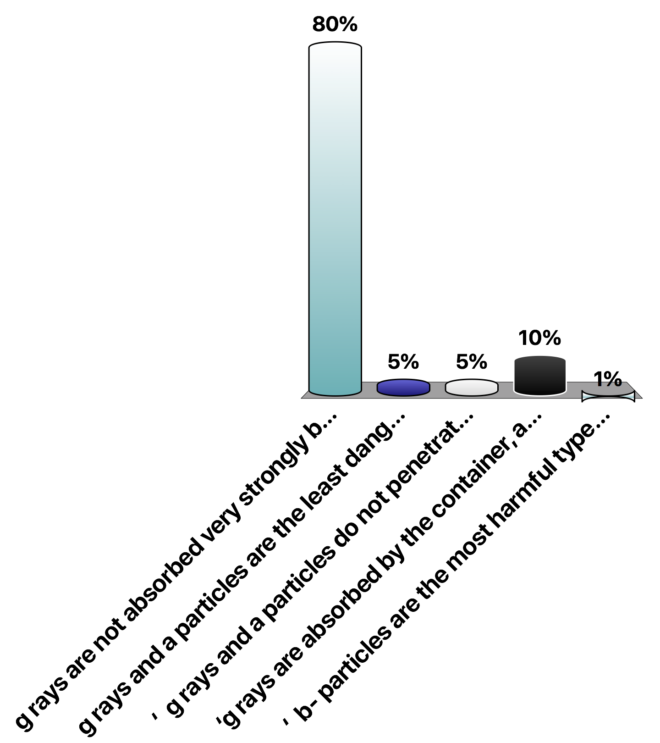
Cardiac pacemakers once used plutonium-238 as a power source. Plutonium-238 decays by the emission of γ rays and α particles. This emission is not particularly harmful because
γ rays are not absorbed very strongly by biological tissue, and α particles do not penetrate beyond the container.
γ rays and α particles are the least dangerous form of radiation.
‘ γ rays and α particles do not penetrate beyond the container.
‘γ rays are absorbed by the container, and α particles do not affect biological tissue.
‘ β⁻ particles are the most harmful type of radiation, and ²³⁸Pu is not a β⁻ emitter.
Notes:
Test bank 122.

Slide 28
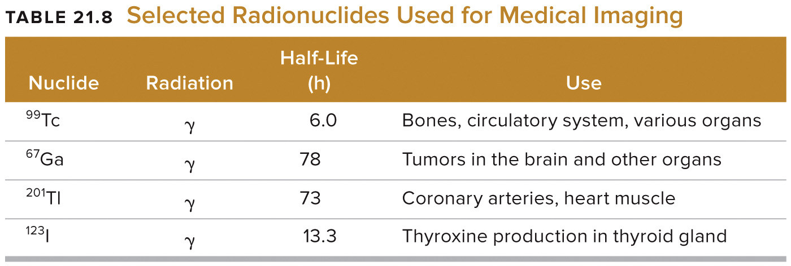
Diagnostic Radiology (Cont. 1)
Positron emission tomography (PET)
Diagnosing organ and cell function
Uses short-lived, neutron-poor, positron-emitting radionuclides (¹¹C, ¹⁵O, ¹⁸F)
Detect γ rays produced by the positron-electron annihilations
Notes:
Positron emission tomography (PET) is a powerful tool for diagnosing organ and cell function. PET uses short-lived, neutron-poor, positron-emitting radionuclides such as carbon-11, oxygen-15, and fluorine-18. A patient might be administered a dose of glucose with some of sugar molecules containing atoms of ¹¹C, ¹⁵O, or ¹⁸F. The rate at which the glucose is metabolized is monitored by detecting the g rays produced by positron-electron annihilations. Unusual patterns in PET images of brains can detect damage from health events and disease.
Table 21.8

Slide 29
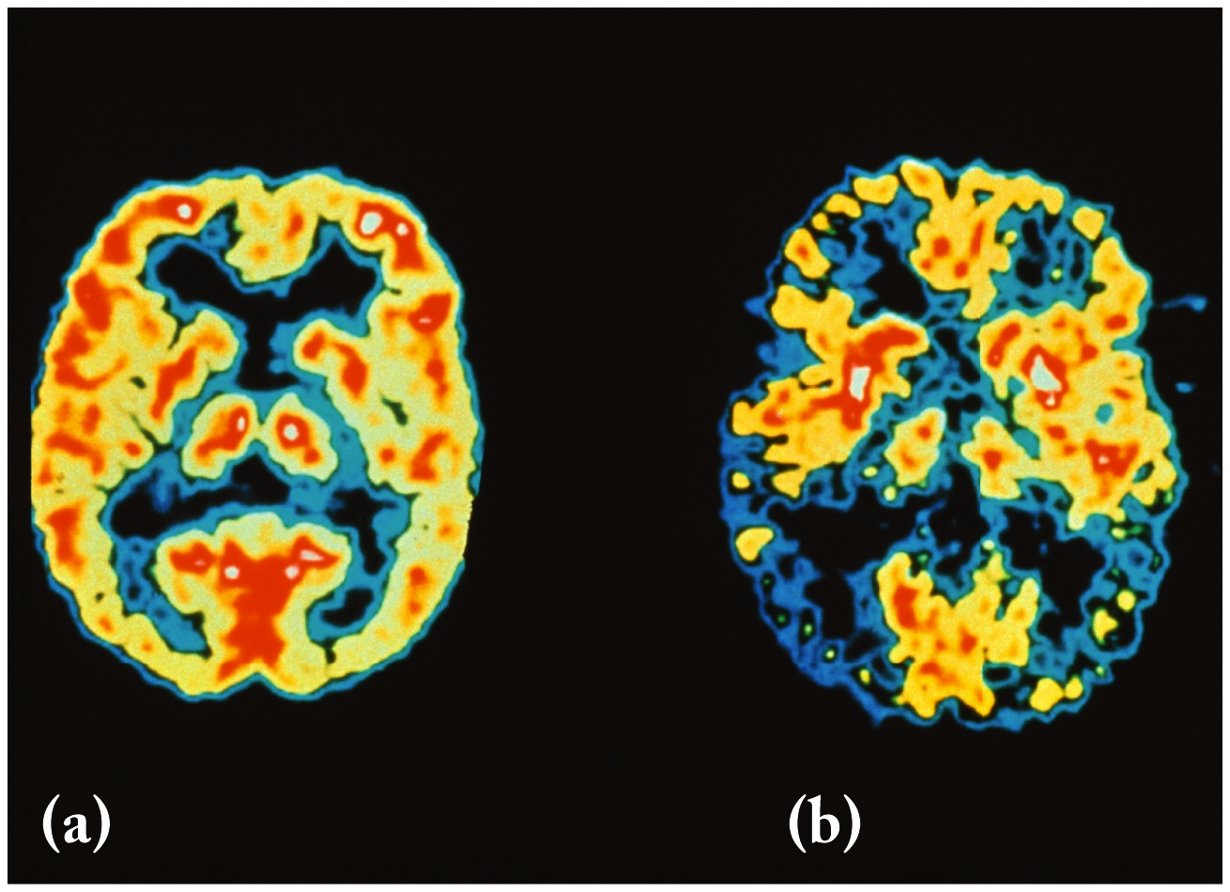
Positron-Emission Tomography (PET)
Healthy brain
Alzheimer’s brain

Slide 30
Medical Applications of Radionuclides
Radionuclides used in detection and the treatment of diseases
Diagnostic radiology
Used alongside nonionizing radiation imaging (MRI)
Therapeutic radiology
Almost always uses ionizing radiation
Notes:
Radionuclides are used in both the detection and treatment of diseases and are the key agents in the respective medical fields of diagnostic radiology and therapeutic radiology. In diagnostic radiology, radionuclides are used alongside magnetic resonance imaging (MRI) and other imaging systems that involve only nonionizing radiation. Therapeutic radiology is based almost entirely on the ionizing radiation that comes from nuclear processes.

Slide 31
Therapeutic Radiology
Radium
Prescribed for cancer treatment, skin lesions, lethargy, arthritis
Modern therapy exposes cancerous cells to γ radiation
External or internal to patient
Iodine
Concentrates in thyroid gland
Beams of γ rays access surgically inaccessible tumors
Damages healthy tissue as well as the cancer tissue
Radiation sickness: Lethargy, nausea, vomiting, hair loss
Notes:
Because ionizing radiation causes the most damage to cells that grow and divide rapidly, it is a powerful tool in the fight against cancer. In the early days of radiochemistry, radium was prescribed in cancer treatment and for ailments that included skin lesions, lethargy, and arthritis. Modern radiation therapy consists of exposing cancerous tissue to g radiation. Often the radiation source is external to the patient but sometimes it is enclosed in a platinum capsule and surgically implanted in cancerous tumor.
A nuclide’s chemical properties can be exploited to direct it to a tumor site. Most iodine in the body is concentrated in the thyroid gland so an effective therapy against thyroid cancer starts with ingestion of potassium iodide containing iodine-123.
Surgically inaccessible tumors can be treated with g rays from sources outside the body. Unfortunately, g radiation destroys both cancer cells and healthy cells. Unfortunately patients receiving radiation treatment suffer symptoms of radiation sickness.

Slide 32
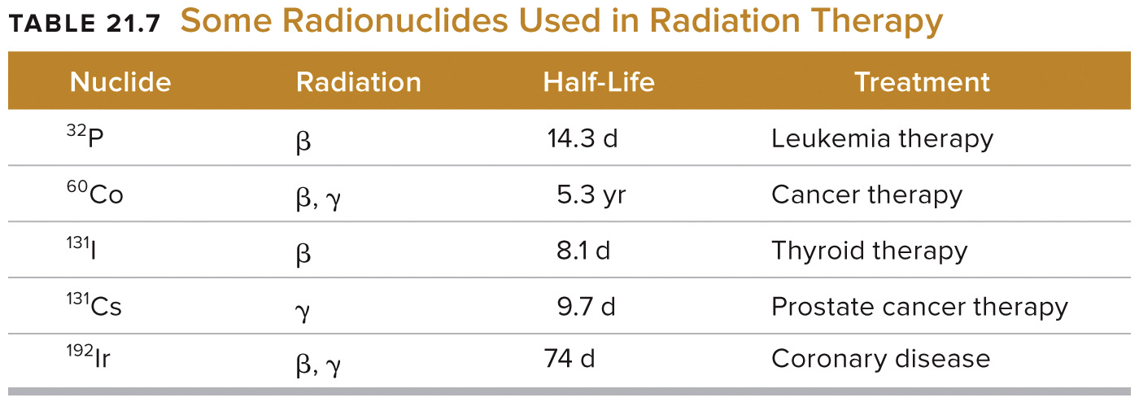
Therapeutic Radiology (Cont. 1)

Slide 33
Diagnostic Radiology
Assess organ function
Transport tiny quantity of radionuclide with a larger amount of stable isotope of same element (tracer) to particular organs
Circulatory system imaged using ²⁴NaCl and monitor γ rays emitted
Ideal isotope
Has half-life close to the time required for procedure
Emit moderate-energy γ rays but not α or β particles
Notes:
The transport of radionuclides in the body and their accumulation in certain organs provide ways to assess organ function. A tiny quantity of a radioactive isotope is used, together with a much larger amount of a stable isotope of the same element. The radioactive isotope is a tracer and the stable isotope is the carrier. The circulatory system can be imaged by injecting into the blood a solution of sodium chloride containing a trace amount of ²⁴NaCl. Circulation is monitored by measuring the g rays emitted by the ²⁴Na.
The ideal isotope for medical imaging is one that has a half-life about equal to the length of time required to perform the imaging measurements. It should emit moderate-energy g rays but no a or b that might cause tissue damage.

Slide 34
Diagnostic Radiology (Cont. 1)
Positron emission tomography (PET)
Diagnosing organ and cell function
Uses short-lived, neutron-poor, positron-emitting radionuclides (¹¹C, ¹⁵O, ¹⁸F)
Detect γ rays produced by the positron-electron annihilations
Notes:
Positron emission tomography (PET) is a powerful tool for diagnosing organ and cell function. PET uses short-lived, neutron-poor, positron-emitting radionuclides such as carbon-11, oxygen-15, and fluorine-18. A patient might be administered a dose of glucose with some of sugar molecules containing atoms of ¹¹C, ¹⁵O, or ¹⁸F. The rate at which the glucose is metabolized is monitored by detecting the g rays produced by positron-electron annihilations. Unusual patterns in PET images of brains can detect damage from health events and disease.
Table 21.8

